Slide 1
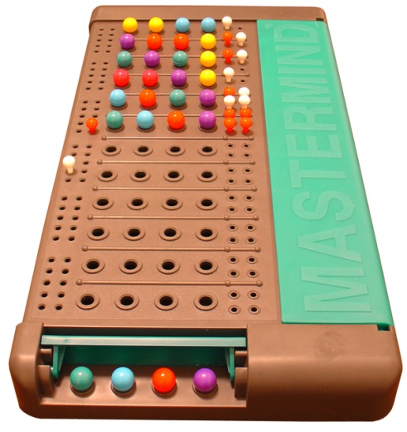

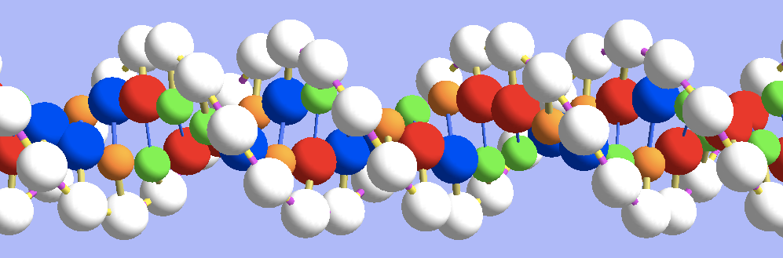
Master Mind
Improvements to existed evolutionary algorithms

Slide 2
Game rules
Game of 2 players.
Each turn one player is the codemaker and the other is the codebreaker.
The codebreaker’s score is the number of guesses it took him to break the code.
Each turn the players change roles.
After known amount of turns the winner is the person with the lower score.
The number of guesses is limited, if exceeded the codemaker wins.

Slide 3
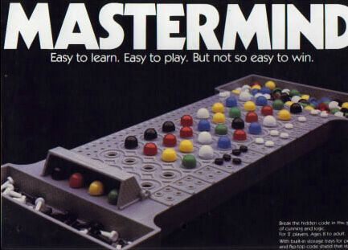
The code and breaking it
Code : combination of colored pegs of fixed size.
The codebreaker places a combination of colored pegs.
The codemaker answers each guess with hints:
black peg for correct color in correct place.
White peg for each peg whose color exist in the secret combination but not in correct place.

Slide 4
Code:

Slide 5
Formalization
Search problem for hidden code which uses hints provide by oracle.
Optimization problem: the goal is to find the code using the lowest number of guesses.
Length of combination: L ,Amount of colors: N.
search size is :N^{L}.
Hint: h(C_{played}, C_{secret})=(n_{b}, n_{w})
On breaking the code: h(C_{played}, C_{secret})=(L,0).
Hint is symmetric: h(C1,C2)=h(C2,C1)
So the goal is to get to: h(C_{played}, C_{secret})=(L,0).

Slide 6
Definitions
A hint together with a combination (c_{played}, h) will be called a rule r.
A combination c is consistent with a rule r iff h= h)c, c_{played}).
A combination c is consistent iff
That means consistent with all rules played before.
Distance: d(c,c_{i}) = d(h(c, c_{i}), h_{i})=
abs(nb-nb_{i}) + abs(nw -nw_{i})

Slide 7
Stepwise optimal approach
Each time play a consistent combination .
First played combination chosen somehow.
C is consistent combination
h(C,C_{played})=h(C_{played},c_{secret})
h is symmetric => h(C,C_{played}) = h(C_{played},C)
h(C_{played},C) = h(C_{played},c_{secret})
C could be the secret combination.
In simple words: a consistent combination can possibly be a solution, since it meets all constraints (in the shape of hints) made so far in the game.

Slide 8
What have we achieved?
Likelihood of reducing the search time.
A direction to go by. (important for evolutionary algorithms)
A way to measure combination without ACTUALLY playing it.
PROBLEM: how to find a consistent combination?

Slide 9
How to find a consistent combination?
Search…
Exhaustive search: store all search space and search from some initial code in systematic way. Complexity : O(N^{L})
Random search: just generates combinations randomly until consistent one is found. The expected value of the number of combinations examined is 0.5 * N^{L}.
Evolutionary algorithm

Slide 10

Evolutionary algorithm
Use the Stepwise optimal approach.
Set the fitness to be the distance from being consistent. ( f(c) = 0 => c is consistent)
Find somehow initial guess
While (not break the code)
find the best combination (closest to consistent) in current generation and play it
Create new generation

Slide 11
Evolutionary algorithm-Specs
Representation: combination = string of valid colors.
Fitness :
Dynamic (fitness of same combination will change according to played combinations)
For already played combination c :
d(c,c) =d(h(c,c),h(c,C_{secret}))= abs(L-nb)+abs(0-nw) =
L -nb + nw
Crossover: interchanges the central segment of two combinations.

Slide 12
Evolutionary algorithm-Specs
Transpose: applies a permutation of the combination. (used to maintain diversity)
Mutation: substitutes one of the colors by the next (circular way).
Number of Generations = Number of guesses.
unbound, until found a solution
or
limited by the game rules of maximum guesses

Slide 13
Evolutionary algorithm-Specs
Selection - rank and elite.
Each generation, the 50% worst combinations are eliminated and substituted by the offspring resulting from the application of the genetic operators to the remaining members of the population.
transposition is applied to 20% of the new combinations.
crossover and mutation to 40% each of the new combinations.

Slide 14
Initial Guess
2 kinds of initial guesses:
L different colors
Could conclude the upper bound of the number of colors in the secret combination.
L /2 different colors
Proposed by Knuth. will give, at least, as much information as the former. (information theory)

Slide 15
Strength and weakness
Strengths:
the approach of getting closer to goal fits this game.
the number of combination evaluated are significantly smaller then other searches => run time is significantly smaller. (see graphs)
Dynamic fitness leads usually to a diverse population so reinitialization of popularity rarely needed.
Weakness:
not playing optimal, meaning not necessarily choosing consistent combination. Result in higher average number of guesses.
Hard to maintain diversity. If going in the longer direction, diversity is needed for “turning back” and shortening the way. (trying to improve using transpose)

Slide 16
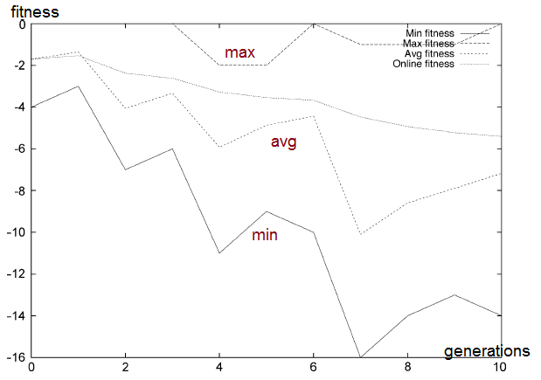
Results
It seem odd that the fitness is decreasing. That is because of adding negative values each generation and because of already played combinations.
What important is the max fitness: always close to 0.

Slide 17
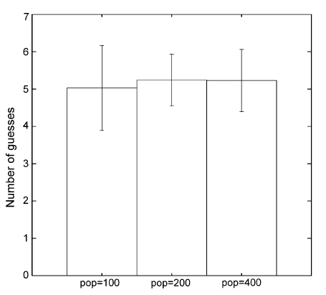
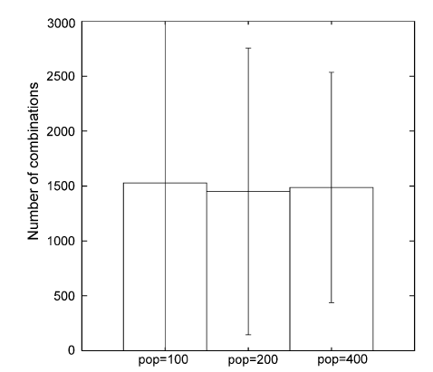
Results
N = 6, L = 6.
main problem : maintain diversity=> bigger populations usually yield slightly better results.
for bigger populations : the number of combinations evaluated has a smaller standard deviation.

Slide 18
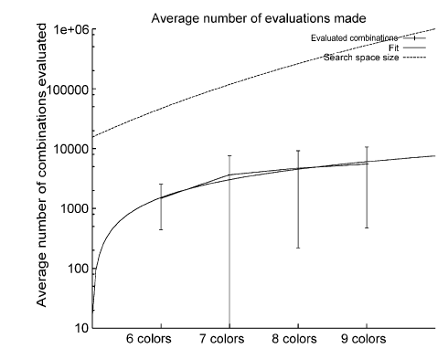
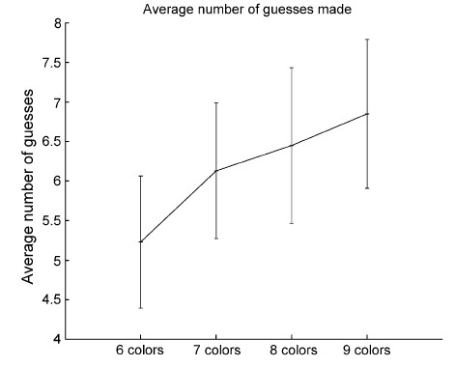
Results
population = 400 . 100 runs .L = 6
even as search space size grows exponentially, the number of combinations evaluated grows only linearly.

Slide 19
State of the art
Roche proves that the number of guesses needed is O(L(log(log L))).
For simple version => 4
For “super” version => 6.076
it does not give numerical values or a strategy to achieve that bound. ☹

Slide 20
State of the art - Compared algorithms
Information Therory
Knuth
first paper that solves Master Mind presented in 1977.
can break the code in 5 guesses or less for the classic game.
Use Strategically optimal approach, meaning combinations are selected in order to:
extracting information about the shape of the hidden combination
reduce the size of remaining search space.
Bestavros and Belal:
use information theory to solve the game: each guess is made in such a way that the answer maximizes information on the hidden code.
Hard work in order to understand which combinations will maximizes the information about the hidden code.

Slide 21
State of the art - Compared algorithms
Search
Koyama and Lai:
use Exhaustive search.
Algorithm run time complexity is O(N^{L}).
Rosu:
Use random search

Slide 22
State of the art - Compared algorithms
Gentic algorithms
Kalisker and D. Camens
combines a simple heuristic with an evolutionary algorithm: 0 for played combinations.
Bento and others :
each generation, the best combination was played.
Fitness: f(c) = d(c,c_{last})

Slide 23
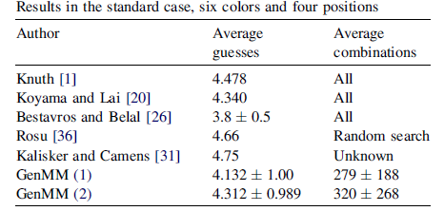
Results - comparison
GenMM (1) -first guess 1122, as suggested by Knuth.
GenMM (2) - playing 1234 first.
Population = 100.
1000 runs.
All=1296
The algorithm is not the best with regard to the number of average guesses but it is with regard to the run time.

Slide 24
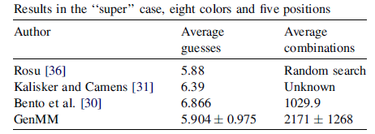
Results - comparison
run 500 times
population = 400.
All=1296
no standard deviation is mentioned and it is thus difficult to compare.
Can be the best at both: average number of guesses and average number of combinations.

Slide 25
Real life similar problems
Circuit testing
Need to generate minimal amount of patterns that covers most faults.
Cryptanalysis
combinations of letters in an alphabet is submitted to a ‘‘black box’’ encrypting device, and the encrypted output is analyzed to crack the key;
the problem is to compute a set of combinations that allow to extract maximal information from the ‘‘black box’’.

